Slide 1







Buildables
Psychepath
MindScan: An ML Powered Mental Health Screening System
Understanding human behavior to influence buying decisions effectively
Presented By
Syed Darain

Slide 2






Buildables
Psychepath
Problem
Many people lack accessible, private first-step screening for depression
Free-text posts can contain signals but are noisy and platform-specific
Need an educational tool (not diagnostic) to raise awareness and guide next steps

Slide 3



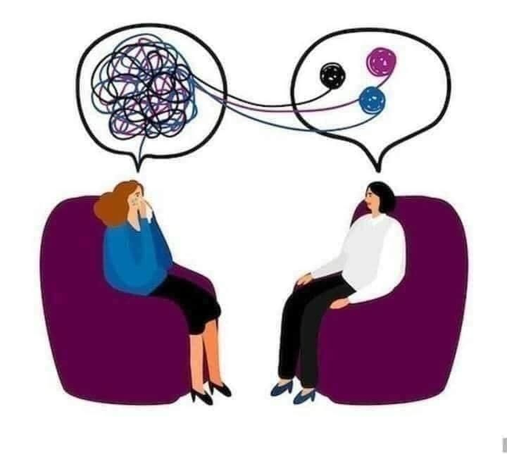
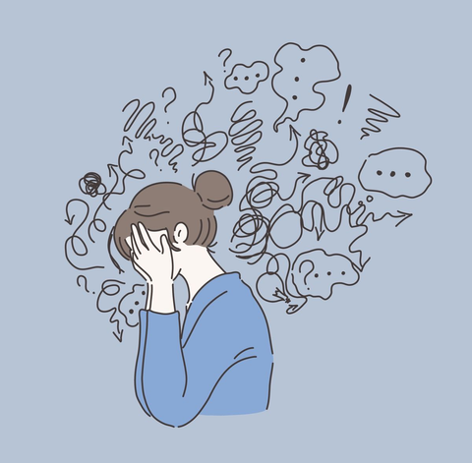

Buildables
Psychepath
Objectives
People buy based on emotion, then justify with logic
Detect “any mental-health concern” vs “normal” from Reddit-style text
Provide quick insights + PHQ‑9 screening in a single interface
Ensure privacy, generalization, and ethical positioning

Slide 4


Buildables
Psychepath
Approach Overview
Pipeline: Data Cleaning EDA Baseline (TF‑IDF+LR) Transformer (DistilBERT) Inference App CI
Evaluate with F1, PR‑AUC; tune threshold for use-case
Ship an interactive Streamlit app with automated CI checks

Slide 5








Buildables
Psychepath
Data & Preprocessing
Source
Cleaning
Length Filter
Kaggle Reddit mental-health dataset
Remove URLs, handles, non-ASCII; lowercase; normalize spaces.
Drop very short posts; save to Parquet for fast I/O

Slide 6




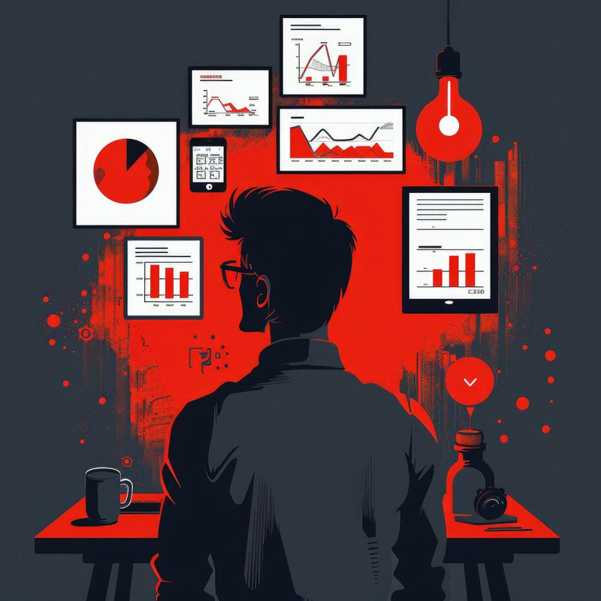



Buildables
Psychepath
EDA Insights
People follow the crowd
Class balance matters
TF‑IDF
Text length differences
Uses text_clean (trade-off: cleaner text but emoji lost)

Slide 7








Buildables
Psychepath
Baseline Model
(TF‑IDF + Logistic Regression)
Train-Test Split
GridSearchCV
Report
Interpretability: positive coefficients (>0) indicate Depression; list top features

Slide 8






Buildables
Psychepath
Transformer Model
Transfer learning
Tokenization
pretrained language understanding adapted to our labels
max_length=256 (speed vs coverage trade‑off)
Trainer
evaluation each epoch, best checkpoint by F1, seed=42

Slide 9

Buildables
Psychepath
Results & Evaluation
Metrics
Threshold tuning
Trade‑offs
classification report (precision/recall/F1)
choose operating point (e.g., maximize F1)
note gains and interpretibility

Slide 10















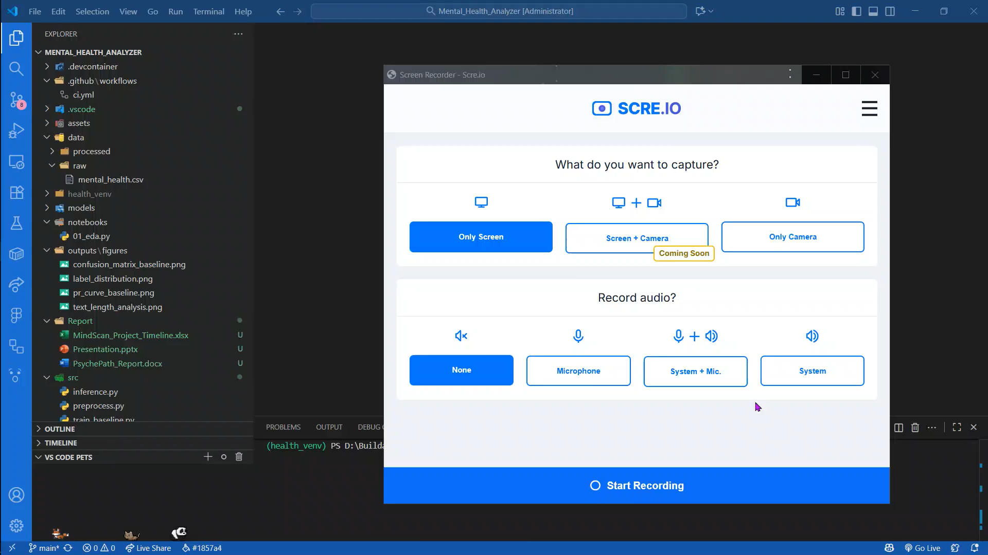





Inference & App
Unified interface
PHQ‑9 scoring
Real‑time predictions
clear disclaimers and crisis resources

Slide 11
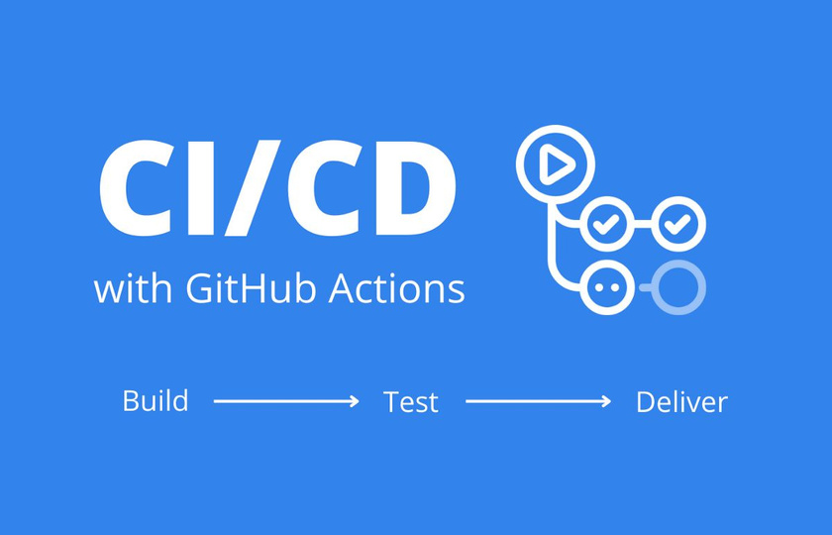
Buildables
Psychepath
CI/CD (GitHub Actions)
On push/PR
Smoke test
install deps (CPU‑only torch), lint (non‑blocking), compile, import modules
launch Streamlit headless, probe endpoint, upload logs
Benefits
fast feedback, reproducibility, fewer broken deployments

Slide 12


Buildables
Psychepath
Impact, Limitations, Next Steps
Impact
Limitations
Future Scope
accessible, private, educational screening; encourages help‑seeking
binary framing, emoji/non‑ASCII dropped, transformer explainability minimal
multi‑class labels, better attributions (LIME/SHAP)

Slide 13






Buildables
Psychepath
Thank You
Very Much
darainhyder21@gmail.com
psychepath.streamlit.app
https://github.com/DarainHyder/MindScan

